Slide 1

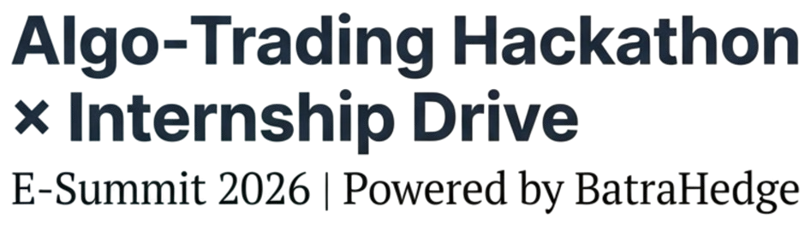
Designing Risk Intelligence, Not Just Models
Team Name: Falcon
Team members: Om Chauhan, Dhruv Patel

Slide 2
Introduction
Understanding what are we actually looking at and going to do .
FINNIFTY Algorithmic Trading System
Structure-Based Trading with Machine Learning
Objective: Develop a profitable algorithmic trading system for FINNIFTYindex
Approach: Combine technical structure analysis with XGBoost machine learning
Period: August 2021 - April 2024 (404,367 1-minute bars)
Tools: Python, XGBoost, Pandas, Scikit-learn

Slide 3
Strategy Overview & Core Intuition
The Core Idea
Strategic Philosophy
Our strategy is built on the principle that price respects structure. Markets move in waves, and optimal entries occur when:
Price retraces to key Fibonacci levels (OTE - Optimal Trade Entry)
Institutional gaps (Fair Value Gaps) remain unfilled
Market regime shows clear directional bias
Why This Works
Fibonacci 0.5-0.7 Zone: The is where smart money accumulates positions
Fair Value Gaps (FVG): Imbalances created by rapid price movements that act as magnets
Market Regime: Trending markets have momentum; we avoid choppy, ranging conditions

Slide 4
Technical Indicators & Features Used
The small elements which help in long run
A. Structure-Based Features
1. Fibonacci Retracement Levels
Calculated over 100-bar lookback window
Key levels: 0.382, 0.500, 0.618, 0.700
OTE Zone: 0.500 - 0.700 (expanded from traditional 0.618-0.786)
2. Fair Value Gaps (FVG)
Bullish FVG: Gap between candle 1 high and candle 3 low
Bearish FVG: Gap between candle 1 low and candle 3 high
Minimum gap: 0.05% of price (relaxed for more signals)
Persistence: 20 bars forward fill
3. Market Regime Classification
Uses ADX (Average Directional Index) with 14-period
Threshold: ADX > 20 (lowered from 25 for more signals)
Classifications: RANGING, TRENDING, STRONG_UPTREND, STRONG_DOWNTREND

Slide 5
Technical Indicators & Features Used
The small elements which help in long run
B. Technical Indicators
Momentum: RSI, MACD, ROC (5/10/20 periods)
Trend: SMA & EMA (5, 10, 20, 50, 200 periods)
Volatility: Bollinger Bands, ATR
Volume: Volume ratio v 20-period MA, volume trend
C. Time-Based Features
Hour of day (market hours: 9:15 AM - 3:30 PM)
Day of week
Days to month end (expiry awareness)
Session period (opening, mid-session, closing)

Slide 6
Entry Logic & Signal Generation
Strategy with which we take entry in our trades
Entry Criteria (Confluence Approach)
Step 1: ML Signal
XGBoost predicts future direction (5-bar horizon)
Probability threshold: 0.3385 (optmz on validation set)
Model trained on 253,539 bars (70% of data)
Step 2: Additional Filters
NOT overstretched (RSI not extreme)
Volume confirmation (volume surge OR trend)
Step 3: Confluence Filters
Entry requires ANY of the following combinations:
Option A: OTE + FVG
Price in OTE zone (0.5-0.7 Fibonacci)
Price in Fair Value Gap
Option B: Strong Trend
Market regime = STRONG_UPTREND
OR Bullish FVG present
Option C: Minimum Momentum
ADX > 15 (directional movement)

Slide 7
Exit Logic & Risk Management
Understanding what are we actually looking at and going to do .
Exit Triggers
1. Take Profit Target
Risk-Reward Ratio: 1:2
Calculation:
Risk = Entry Price - Stop Loss
Take Profit = Entry Price + (2 × Risk)
Example: Entry = 20,000, SL = 19,800
Risk = 200 points
TP = 20,400 (200 points × 2)
2. Chandelier Trailing Stop
Formula: Highest High (22 bars) - (3 × ATR)
Trails upward only (locks in profits)
Adapts to volatility automatically
3. Opposite Signal
ML probability drops below 0.3 (30%)
Indicates potential reversal
4. Trend Weakening
ADX falls below threshold
Loss of directional momentum
5. Position Sizing
Fixed: 10% of current capital per trade
Commission: 0.03% per trade
Slippage: 0.01% per trade
Initial Capital: $100,000

Slide 8
Risk Management Framework
Understanding what are we actually looking at and going to do .
A. Portfolio-Level Risk
Max Drawdown Tolerance: 10%
Max Concurrent Positions: 1
B. Execution Risk
Slippage: 0.01% factored into all trades
Commission: 0.03% per trade
Entry/Exit Timing: Market orders with realistic fills
C. Strategy Risk Controls
Overstretched Filter: Avoid entering in extreme conditions (RSI > 80 or < 20)
Regime Filter: Only trade in trending markets (avoid chop)
Volume Filter: Ensure liquidity and conviction
Chandelier Stop: Automatic risk adjustment based on volatility

Slide 9
Machine Learning Architecture
Designing for Signal, Stability, and Scale.
Model Selection: XGBoost Classifier
Why XGBoost?
Handles non-linear relationships in market data
Built-in regularization prevents overfitting
Feature importance for interpretability
Fast training and prediction
Robust to imbalanced classes
Feature Engineering Pipeline
Raw Data (OHLCV) → 8 columns
Structure Features (Fib, FVG, Regime) → +25 features
Technical Indicators (SMA, RSI, MACD) → +30 features
Time Features (Hour, Day, Expiry) → +8 features
Lag Features (Returns, Volume) → +9 features
Total: 70+ features → Model ready

Slide 10
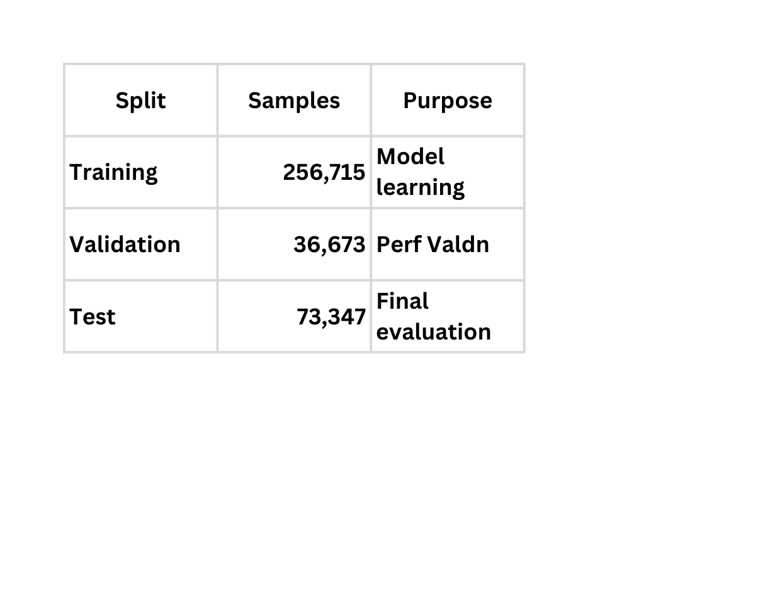
Training Process & Data Splits
Understanding what are we actually looking at and going to do .
Chronological Splitting Strategy
Method: Strict time-series split (no random shuffling) to simulate real-world forecasting.
Train Set (2021 – Jan 2026)
Validation Set (Jan 2023 – July 2023):
Test Set (July 2023 – April 2024)
Data Preparation Pipeline
Cleaning: Rows with NaN targets or >50% missing features were dropped to ensure data integrity.
Scaling: Applied StandardScaler to normalize all input features (Mean=0, Variance=1), ensuring idicators like Volume don't dominate oscillating indicators like RSI.
Imbalance Handling: The dataset was naturally balanced (~50/50 Up/Down split).

Slide 11
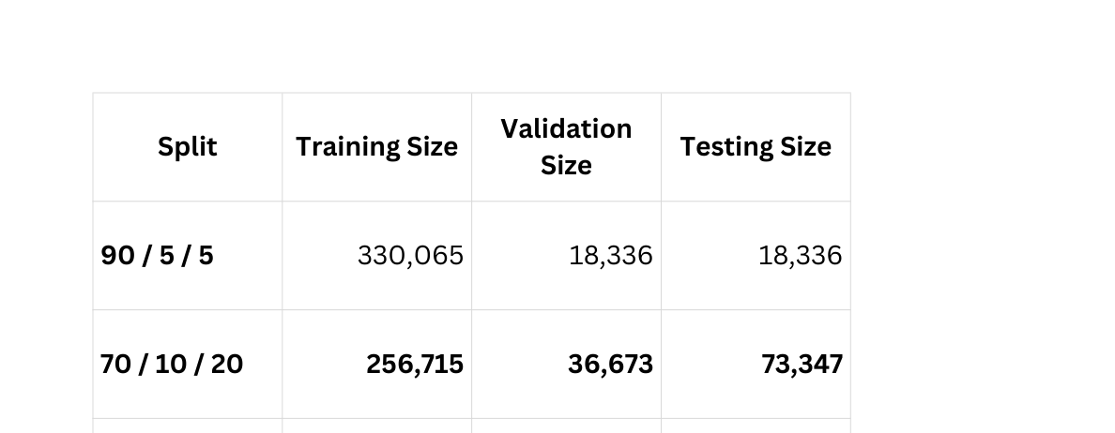
Validation Strategy
“Ensuring Fair and Representative Model Evaluation.
Original Dataset
Total samples: 366,737
Why Hold-Out Validation?
Training performance alone is misleading
Models may memorize training patterns (overfitting)
Validation data simulates unseen future customers
Random Split Risk
Training data may have irregular split
Validation and Testing can give different results
Safety Check
The pipeline explicitly drops rows with NaN targets to ensure data integrity.

Slide 12
Testing Strategy
Testing That Reflects Real-World Performance.
Evaluate performance using both statistical metrics and financial reality.
Evaluation Metrics (ML Layer)
ROC-AUC: Primary metric to measure the model's ability to distinguish between "Up" and "Down" moves (Result: 0.5636, indicating weak predictive power).
Precision vs. Recall: Analyzed the trade-off between capturing moves (Recall) and being correct (Precision).
Confusion Matrix: Monitored False Positives (bad trades) vs. True Positives to understand error distribution.
Backtesting Engine (Financial Layer)
Simulation: Realistic trade execution using the Test Set (unseen data).
Constraints: Included transaction costs (Commission: 0.03%, Slippage: 0.01%) to punish over-trading.
Risk Management: Implemented Chandelier Exits (Trailing Stop) and fixed Risk:Reward (1:2) targets.
Reality Check: The backtest revealed a -55.30% return, highlighting that while the ML mechanics worked, but the underlying signal was not profitable.

Slide 13
Optuna Hyperparameter Tuning
Searching the Space Where Performance Actually Lives
Optimization Strategy
50 Optuna trials per model
Tuned XGBoost
Hyperparameter Focus
Model Capacity: max_depth , max_delta_step , gamma
Learning Dynamics: learning_rate , n_estimators
Regularization: reg_alpha , reg_lambda , min_child_weight
Sampling: subsample , colsample_bytree ,
colsample_bylevel

Slide 14
Optuna Hyperparameter Tuning
Searching the Space Where Performance Actually Lives
XGBoost Hyperparameters:
- max_depth: 6
- learning_rate: 0.05
- n_estimators: 1000
- min_child_weight: 3
- subsample: 0.8
- colsample_bytree: 0.8
- colsample_bylevel: 0.5
- gamma: 0.1
- reg_alpha: 0.1
- reg_lambda: 1.0
- max_delta_step: 2
Performance: Value = 0.6291
XGBoost Hyperparameters:
- max_depth: 9
- learning_rate: 0.015816981413469905
- n_estimators: 400
- min_child_weight: 3
- subsample: 0.6389274219025062
- colsample_bytree: 0.9987349142404867
- colsample_bylevel: 0.7705609360826743
- gamma: 0.28155316324336543
- reg_alpha: 1.7346201315788978
- reg_lambda: 3.2706207110759644
- max_delta_step: 4
Performance: Value = 0.6746

Slide 15
Key Findings & Final Results
Made for learning , not just score.
1. Critical Failure
Net Result: $45,248 (Total Loss)
Drawdown: -45.25% loss of total equity.
Reliability: 0 Profitable Months
2. The Core Problems
Win Rate: 9.8% (Only 1 in 10 trades makes money).
Risk/Reward Inversion:
Avg Win: $5.81
Avg Loss: $10.95
Result: You lose nearly $2 for every $1 you make.
Over-Trading: 4,867 trades suggests signal noise, not signal quality.
3. The "Exit" Paradox
Data Conflict: The system claims 58% of exits were "Take Profits," yet the win rate is only 9%.
Conclusion: The "Take Profit" targets are likely set so tight they fail to cover spread/commissions, turning technical wins into realized losses.
Time-Frame should have been 5-min.
Option greeks (Theta decay)

Slide 16

Questions?
Project Repository: https://github.com/OmChauhan2023/Falcon-
Contact: 9998986977
Date: 31st January 2026

